Slide 1
Data Structures & Algorithms Design
Topic: Merge sort
Dr. J Angel Arul Jothi
Department of Computer Science

Slide 2
Text Book Chapter 4
Section 4.1

Slide 3
Divide-and-Conquer
Divide-and conquer is a algorithm design paradigm
  Divide:
    If input data is less than a threshold then solve the problem directly and return the solution
    Otherwise divide the input data in two or more disjoint subsets
  Recur: Solve the subproblems associated with the subsets recursively
  Conquer: Merge the solutions for subproblems into a solution for original problem
The base case for the recursion is subproblems of size 0 or 1
CS F211 DATA STRUCTURES & ALGORITHMS

Slide 4
Merge sort
Merge-sort applies the divide-and-conquer technique to the sorting problem
Merge-sort on an input sequence A with n elements consists of three steps:
  Divide:
    If A has zero or one element then return A
    Otherwise partition A into two sequences A₁ and A₂ of about n/2 elements each
  Recur:
    Recursively sort A₁ and A₂
  Conquer:
    Merge A₁ and A₂ into a sorted sequence
CS F211 DATA STRUCTURES & ALGORITHMS

Slide 5
Merge sort
Algorithm mergeSort(A, p, r)
if p < r
q ← floor((p + r)/2)
mergeSort (A, p, q)
mergeSort (A, q+1, r)
merge (A, p, q, r)
CS F211 DATA STRUCTURES & ALGORITHMS

Slide 6
Merge sort
Algorithm merge(A, p, q, r)
n1 ← q-p+1
n2 ← r-q
Let L[0…(n1-1)]
Let R[0…(n2-1)]
for i ← 0 to n1-1
L[i] ← A[p+i]
for i ← 0 to n2-1
R[i] ← A[q+i+1]
i ← 0
j ← 0
k ← p
while i< n1 and j <n2
if L[i] < = R[j]
A[k] ← L[i]; i=i+1
else
A[k] ← R[j]; j ← j+1
k ← k+1
while i< n1
A[k] ← L[i]
i ← i+1; k ← k+1
while j < n2
A[k] ← R[j]
j ← j+1; k ← k+1
CS F211 DATA STRUCTURES & ALGORITHMS

Slide 7
Merge (A, 0, 1, 3)
A
14
23
6
33
Algorithm merge(A, p, q, r)
n1 = q-p+1
n2 = r-q
Let L[1…n1] and R[1…n2]
for i = 0 to n1-1 // (i<n1)
L[i] = A[p+i]
for i= 0 to n2-1 // (i < n2)
R[i] = A[q+i+1]
n1= 1-0+1=2
n2 = 3-1 = 2
L[n1], R[n2]
i=0, 1,
L[0]=A[0+0]= 14
L[1]=A[0+1] = 23
i = 0, 1
R[0]=A[1+0+1]=A[2] =6
R[1]=A[1+0+2] = A[3] = 33
L
14
23
6
33
R
CS F211 DATA STRUCTURES & ALGORITHMS

Slide 8
Merge (A, 0, 1, 3)
i ← 0
j ← 0
k = p
while i< n1 and j <n2
if L[i] < = R[j]
A[k] = L[i]; i=i+1
else
A[k] = R[j]; j=j+1
k = k+1
L
14
23
6
33
R
i = 0
j = 0
A
k = 0
CS F211 DATA STRUCTURES & ALGORITHMS

Slide 9
Merge (A, 0, 1, 3)
while i< n1 and j <n2
if L[i] < = R[j]
A[k] = L[i]; i=i+1
else
A[k] = R[j]; j=j+1
k = k+1
L
14
23
6
33
R
i =0
j = 1
A
6
k = 1
Merge
CS F211 DATA STRUCTURES & ALGORITHMS

Slide 10
Merge (A, 0, 1, 3)
while i< n1 and j <n2
if L[i] < = R[j]
A[k] = L[i]; i=i+1
else
A[k] = R[j]; j=j+1
k = k+1
L
14
23
6
33
R
i =1
j =1
A
6
14
k = 2
Merge
CS F211 DATA STRUCTURES & ALGORITHMS

Slide 11
Merge (A, 0, 1, 3)
while i< n1 and j <n2
if L[i] < = R[j]
A[k] = L[i]; i=i+1
else
A[k] = R[j]; j=j+1
k = k+1
L
14
23
6
33
R
i = 2
j = 1
A
6
14
23
k = 3
Merge
CS F211 DATA STRUCTURES & ALGORITHMS

Slide 12
Merge (A, 0, 1, 3)
while i< n1
A[k] = L[i]
i=i+1; k = k+1
while j < n2
A[k] = R[j]
j=j+1; k = k+1
L
14
23
6
33
R
i = 2
j = 2
A
6
14
23
33
k = 4
Merge
CS F211 DATA STRUCTURES & ALGORITHMS

Slide 13
Merge sort
Merge algorithm
  Merging two sorted sequences
  A is an array/subarray and p, q, and r are indices into the array such that p <= q <= r
  The subarrays A[p..q] and A[q..r] are in sorted order
  The algorithm merges them to form a single sorted subarray that replaces the current subarray A[p..r]
  Algorithm takes O(n) time and uses O(n) extra space
CS F211 DATA STRUCTURES & ALGORITHMS

Slide 14
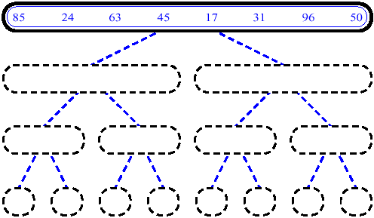
Merge sort (Example) - 1
mergeSort(A, 0, 7)
if p < r // 0 < 7 True
q ← 3 // (0+7)/2
mergeSort (A, 0, 3)
mergeSort (A, 4, 7)
merge (A, 0, 3, 7)
CS F211 DATA STRUCTURES & ALGORITHMS

Slide 15
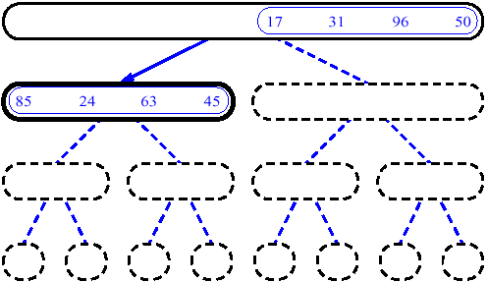
Merge sort (Example) - 2
mergeSort(A, 0, 3)
if p < r // 0<3 True
q ← 1 // (0+3)/2
mergeSort (A, 0, 1)
mergeSort (A, 2, 3)
merge (A, 0, 1, 3)
CS F211 DATA STRUCTURES & ALGORITHMS

Slide 16
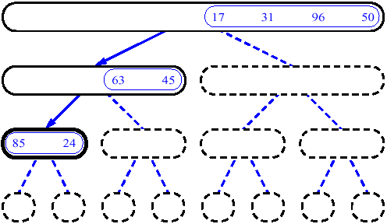
Merge sort (Example) - 3
mergeSort(A, 0, 1)
if p < r // 0 < 1 True
q ← 0 // (0+1)/2
mergeSort (A, 0, 0)
mergeSort (A, 1, 1)
merge (A, 0, 1, 1)
CS F211 DATA STRUCTURES & ALGORITHMS

Slide 17
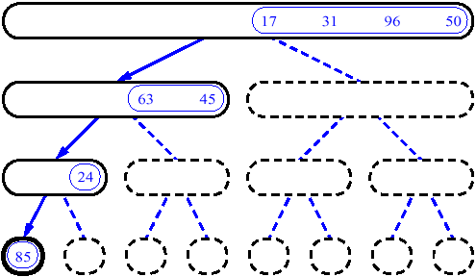
Merge sort (Example) - 4
mergeSort(A, 0, 0)
if p < r //0 <0 False
Returns back control to the calling function
CS F211 DATA STRUCTURES & ALGORITHMS

Slide 18
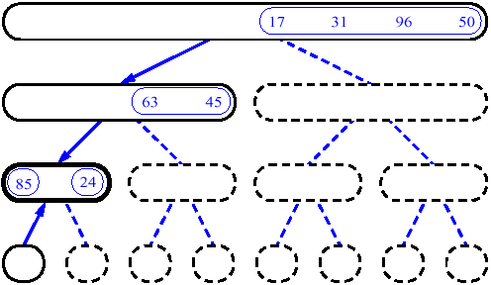
Merge sort (Example) - 5
mergeSort(A, 0, 1)
if p < r
q ← 0
mergeSort (A, 0, 0)
mergeSort (A, 1, 1)
merge(A, 0, 1, 1)
CS F211 DATA STRUCTURES & ALGORITHMS

Slide 19
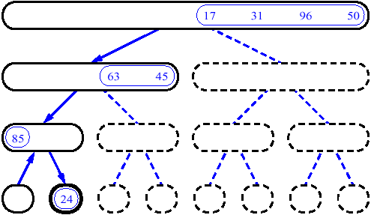
Merge sort (Example) - 6
mergeSort(A, 1, 1)
if p < r // 1 < 1 False
Returns back control to the calling function
CS F211 DATA STRUCTURES & ALGORITHMS

Slide 20
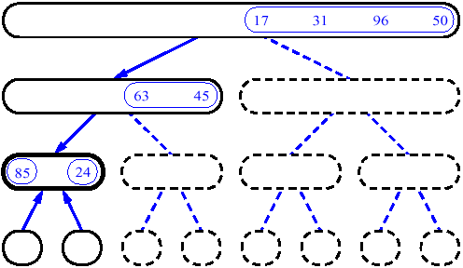
Merge sort (Example) - 7
mergeSort(A, 0, 1)
if p < r
q ← 0
mergeSort (A, 0, 0)
mergeSort (A, 1, 1)
merge (A, 0, 1, 1)
Perform merge
CS F211 DATA STRUCTURES & ALGORITHMS

Slide 21
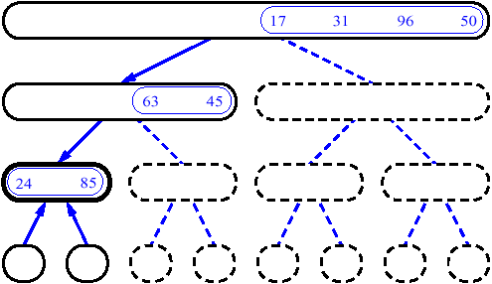
Merge sort (Example) - 8
mergeSort(A, 0, 1)
if p < r
q ← 0
mergeSort (A, 0, 0)
mergeSort (A, 1, 1)
merge(A, 0, 1, 1)
After merge
Returns back control to the calling function
CS F211 DATA STRUCTURES & ALGORITHMS

Slide 22
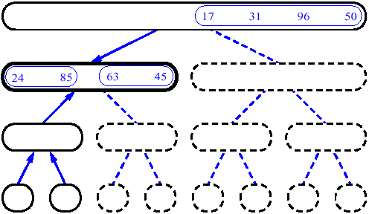
Merge sort (Example) - 9
mergeSort(A, 0, 3)
if p < r
q ← 1
mergeSort (A, 0, 1)
mergeSort (A, 2, 3)
merge (A, 0, 1, 3)
CS F211 DATA STRUCTURES & ALGORITHMS

Slide 23
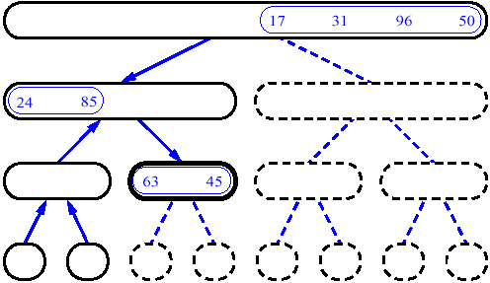
Merge sort (Example) - 10
mergeSort(A, 2, 3)
if p < r
q ← 2
mergeSort (A, 2, 2)
mergeSort (A, 3, 3)
merge (A, 2, 2, 3)
CS F211 DATA STRUCTURES & ALGORITHMS

Slide 24
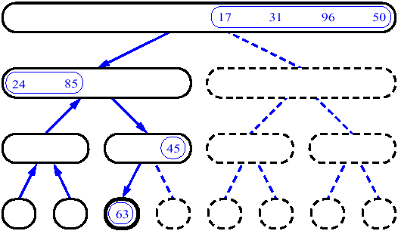
MergeSort (Example) - 11
mergeSort(A, 2, 2)
if p < r
Returns back control to the calling function
CS F211 DATA STRUCTURES & ALGORITHMS

Slide 25
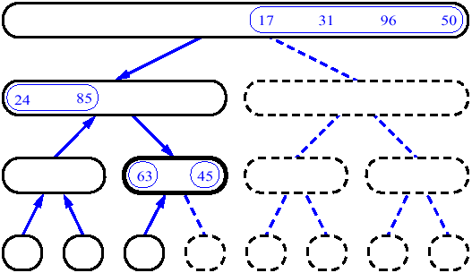
Merge sort (Example) - 12
mergeSort(A, 2, 3)
if p < r
q ← 2
mergeSort (A, 2, 2)
mergeSort (A, 3, 3)
merge (A, 2, 2, 3)
CS F211 DATA STRUCTURES & ALGORITHMS

Slide 26
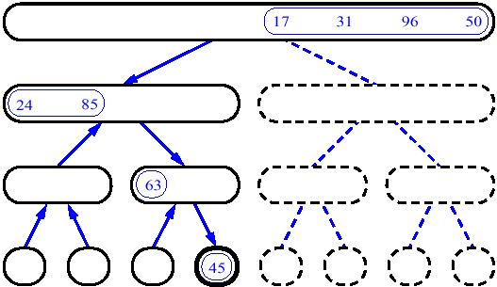
MergeSort (Example) - 13
mergeSort(A, 3, 3)
if p < r
Returns back control to the calling function
CS F211 DATA STRUCTURES & ALGORITHMS

Slide 27
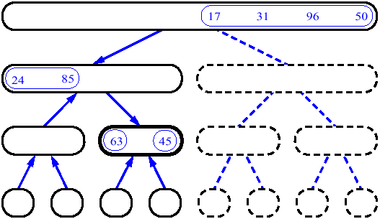
Merge sort (Example) - 14
mergeSort(A, 2, 3)
if p < r
q ← 2
mergeSort (A, 2, 2)
mergeSort (A, 3, 3)
merge (A, 2, 2, 3)
Perform merge
CS F211 DATA STRUCTURES & ALGORITHMS

Slide 28
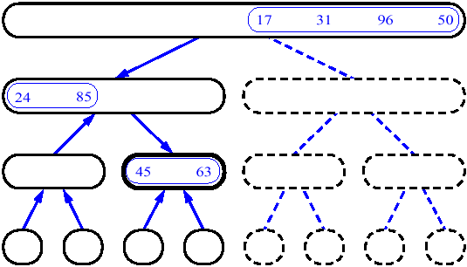
MergeSort (Example) - 15
mergeSort(A, 2, 3)
if p < r
q ← 2
mergeSort (A, 2, 2)
mergeSort (A, 3, 3)
merge (A, 2, 2, 3)
After merge
Returns back control to the calling function
CS F211 DATA STRUCTURES & ALGORITHMS

Slide 29
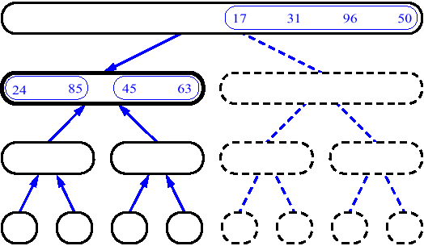
Merge sort (Example) - 16
mergeSort(A, 0, 3)
if p < r
q ← 1
mergeSort (A, 0, 1)
mergeSort (A, 2, 3)
merge (A, 0, 1, 3)
Perform merge
CS F211 DATA STRUCTURES & ALGORITHMS

Slide 30
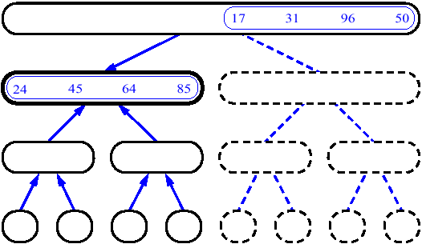
Merge sort (Example) - 17
mergeSort(A, 0, 3)
if p < r
q ← 1
mergeSort (A, 0, 1)
mergeSort (A, 2, 3)
merge ← (A, 0, 1, 3)
After merge
Returns back control to the calling function
CS F211 DATA STRUCTURES & ALGORITHMS

Slide 31
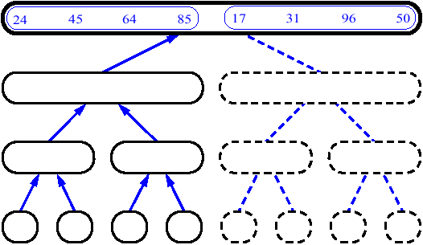
Merge sort (Example) - 18
mergeSort(A, 0, 7)
if p < r
q ← 3
mergeSort (A, 0, 3)
mergeSort (A, 4, 7)
merge (A, 0, 3, 7)
CS F211 DATA STRUCTURES & ALGORITHMS

Slide 32
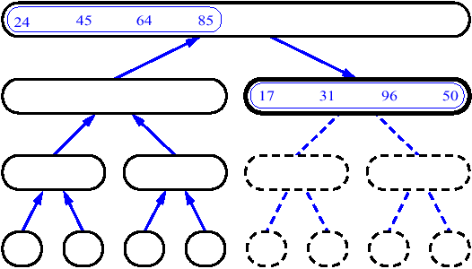
MergeSort (Example) - 19
mergeSort(A, 4, 7)
if p < r
q ← 5
mergeSort (A, 4, 5)
mergeSort (A, 6, 7)
merge (A, 4, 5, 7)
CS F211 DATA STRUCTURES & ALGORITHMS

Slide 33
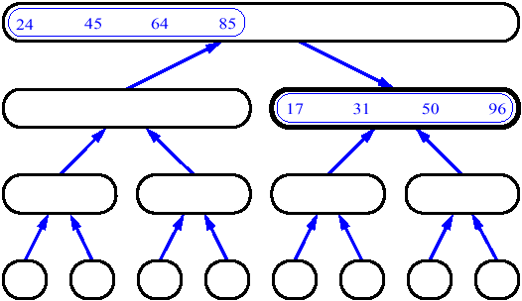
Merge sort (Example) - 20
mergeSort(A, 0, 7)
if p < r
q ← 3
mergeSort (A, 0, 3)
mergeSort (A, 4, 7)
merge (A, 0, 3, 7)
CS F211 DATA STRUCTURES & ALGORITHMS

Slide 34
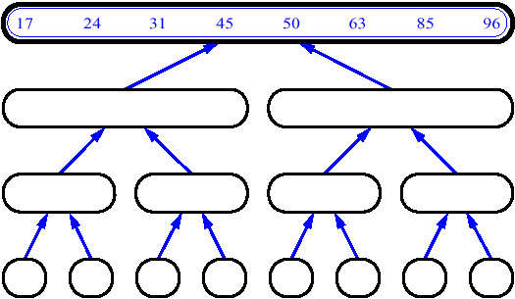
Merge sort (Example) - 22
mergeSort(A, 0, 7)
if p < r
q ← 3
mergeSort (A, 0, 3)
mergeSort (A, 4, 7)
merge (A, 0, 3, 7)
CS F211 DATA STRUCTURES & ALGORITHMS

Slide 35
Analysis of Merge sort
Algorithm mergeSort(A, p, r) --------- T(n)
if p < r
q ← floor((p + r)/2) ------ O(1)
mergeSort (A, p, q) ------ T(n/2)
mergeSort (A, q+1, r) ------ T(n/2)
merge ← (A, p, q, r) ------ O(n)
CS F211 DATA STRUCTURES & ALGORITHMS

Slide 36
Analysis of Merge sort
Running time T(n) of Merge Sort:
  Divide: computing the middle takes O(1)
  Conquer: solving 2 sub problems takes 2T(n/2)
  Combine: merging n elements takes O(n)
Total:
  T(n) = O(1) if n = 1
  T(n) = 2T(n/2) + O(n) +O(1) if n > 1
  T(n) = 2T(n/2) + O(n) if n > 1
  Solving the recurrence equation by iterative back substitution method we get T(n) = O(n logn)
CS F211 DATA STRUCTURES & ALGORITHMS

Slide 37
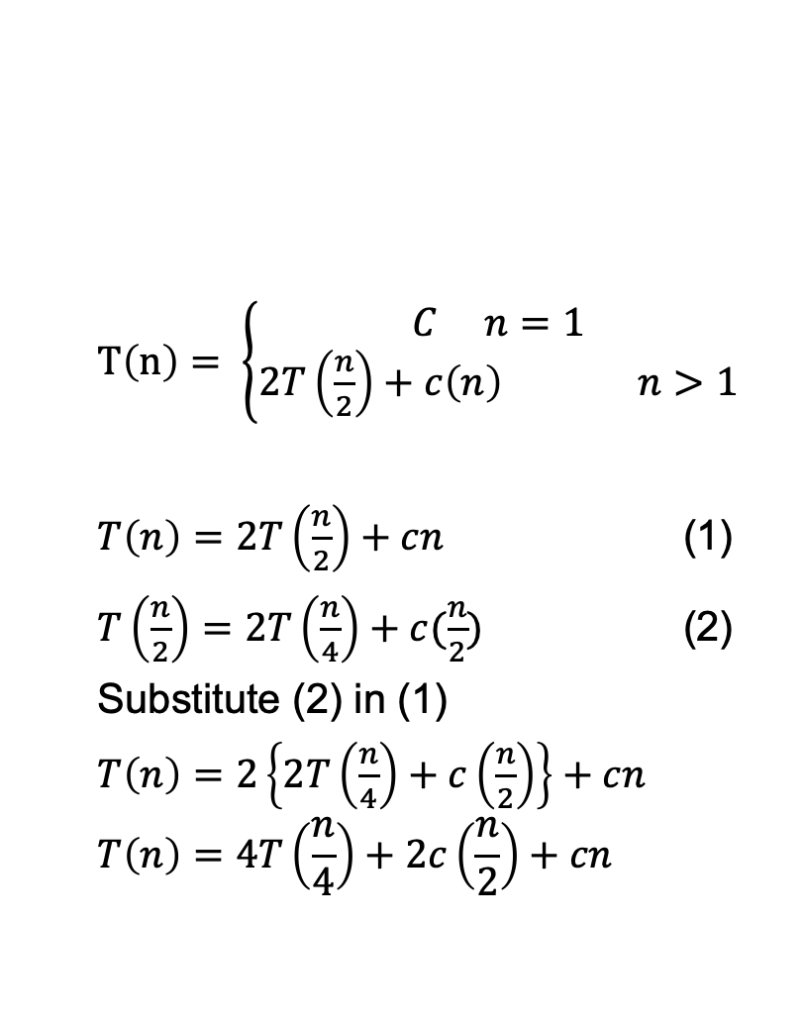
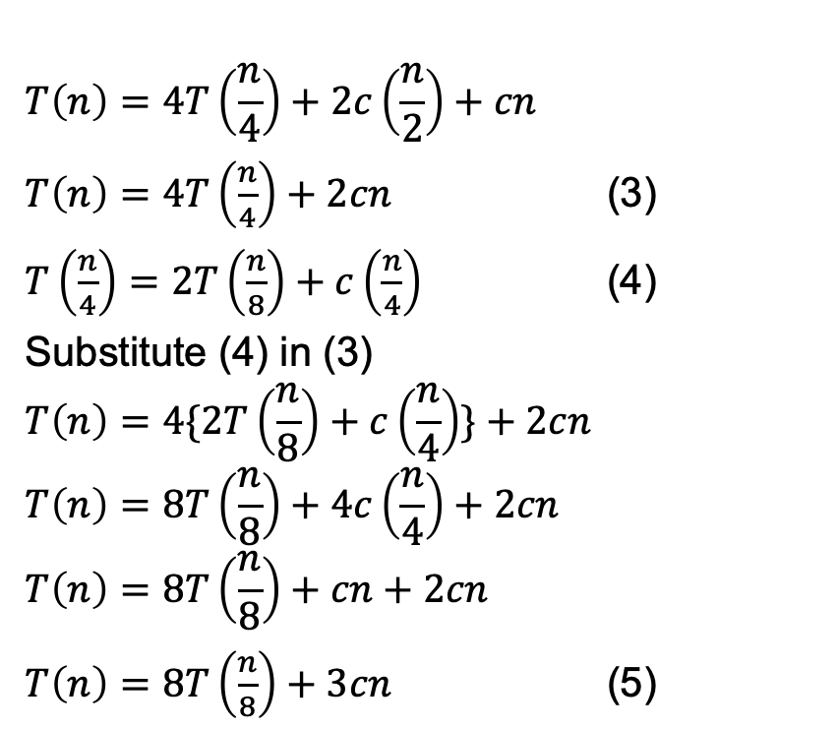
Iterative Back Substitution Method
Recursively it will go on…….
CS F211 DATA STRUCTURES & ALGORITHMS

Slide 38
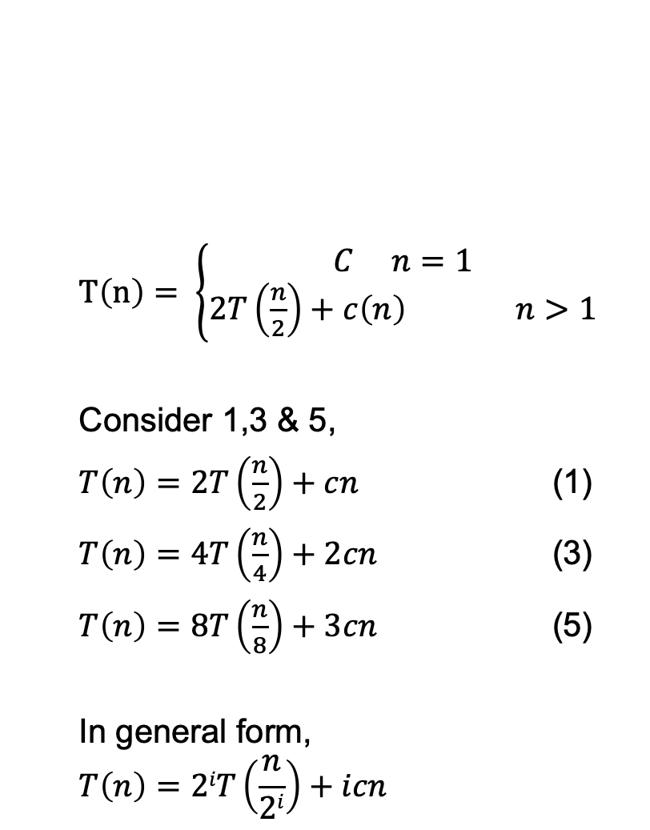
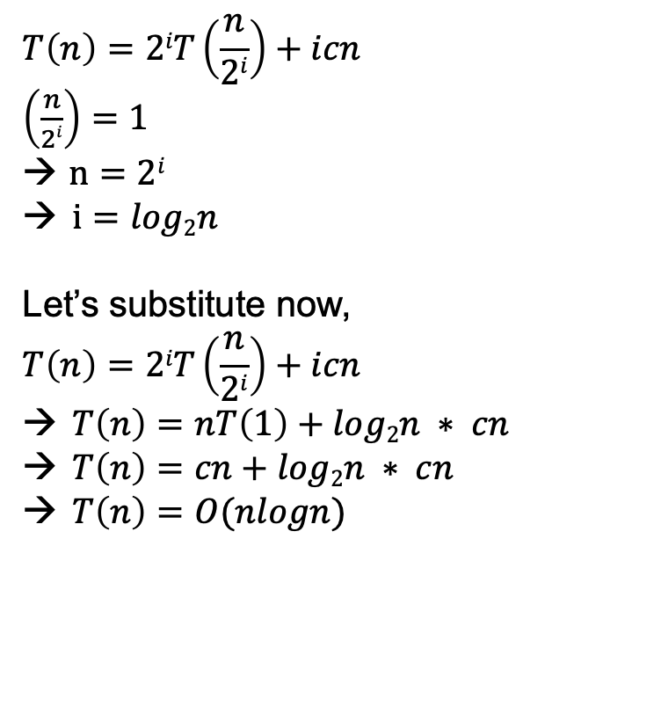
Iterative Back Substitution Method
CS F211 DATA STRUCTURES & ALGORITHMS

Slide 39
Analysis of Merge sort
Recursion tree method
For simplicity let us assume that the merge-sort algorithm is given an input sequence of n elements where we assume n is a power of 2
The execution of the merge-sort algorithm is depicted by means of a binary tree called the merge-sort tree
The time spent at a node v of T is the running time of the recursive call associated with v, excluding the time taken waiting for the recursive calls associated with the children of v to terminate
CS F211 DATA STRUCTURES & ALGORITHMS

Slide 40
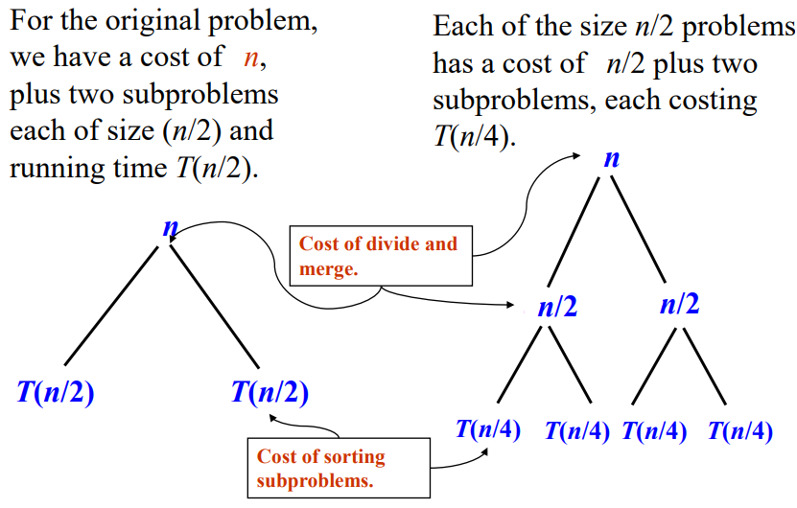
Analysis of Merge sort
Recursion tree method
CS F211 DATA STRUCTURES & ALGORITHMS

Slide 41
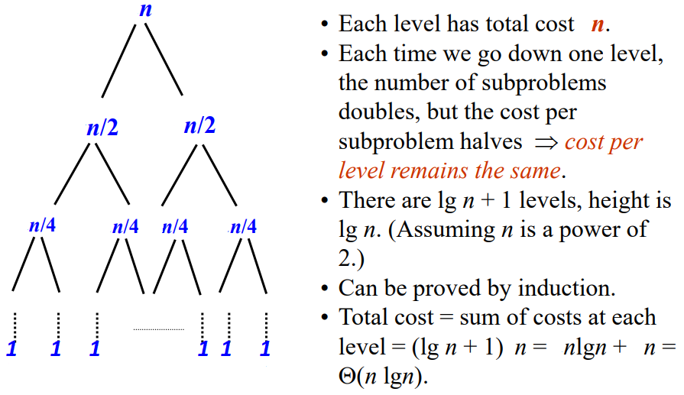
Analysis of Merge sort
Recursion tree method
CS F211 DATA STRUCTURES & ALGORITHMS

Slide 42
Analysis of Merge sort
Recursion tree method
The height h of the merge-sort tree is (log n)
  at each recursive call we divide in half the sequence,
The overall amount or work done at the nodes of depth i is O(n)
  we partition and merge 2^{i} sequences of size n/2^{i}
  we make 2^{i+1} recursive calls
Thus, the total running time of merge-sort is O(n log n)
depth | #sub probs | Size of subprobs
0 | 1 | n
1 | 2 | n/2
i | 2^{i} | n/2^{i}
… | … | …
CS F211 DATA STRUCTURES & ALGORITHMS

Slide 43
Merge sort
Used when we have very large input
If we use linked list representation to hold the sequence then, the merge procedure need not create an extra linked list for the final sorted list. Only the pointers need to be adjusted to create the final sorted list
Supports external sorting
Stable storing (order of duplicates in input is preserved in the sorted output)
Not in-place sorting (Needs extra space for sorting).
Uses O(n) extra space for the array
CS F211 DATA STRUCTURES & ALGORITHMS

Slide 44
Thank you
CS F211 DATA STRUCTURES & ALGORITHMS

